Slide 1

Lecture: Solar cell technologies, world records and some new concepts

Slide 2
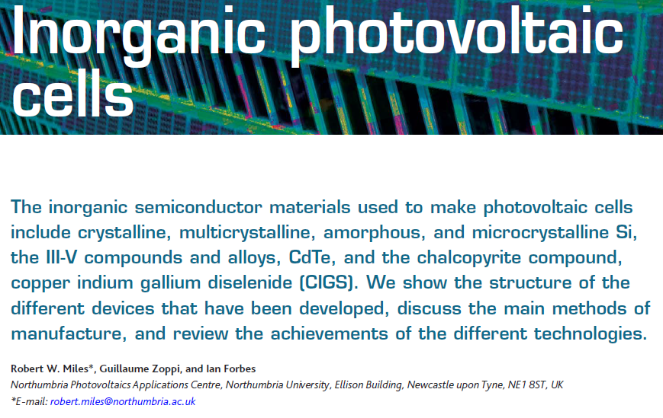
Review papers on PV … there are lots
“Materials Today” 2007

Slide 3
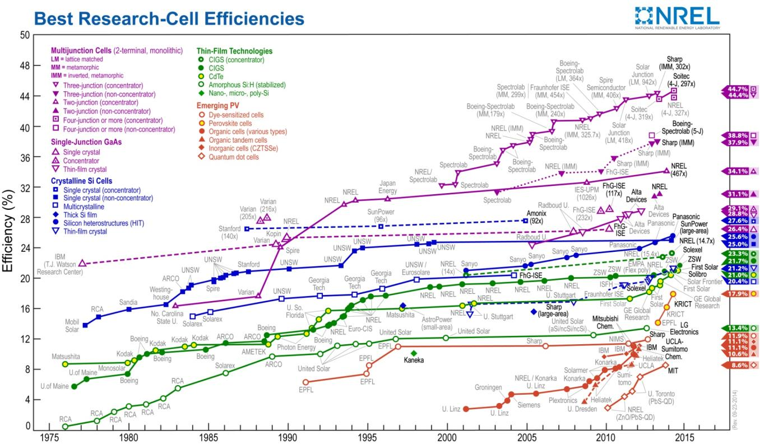
NREL efficiency chart – one of a kind cells
http://www.nrel.gov/ncpv/images/efficiency_chart.jpg
Download the latest version for your work!

Slide 4
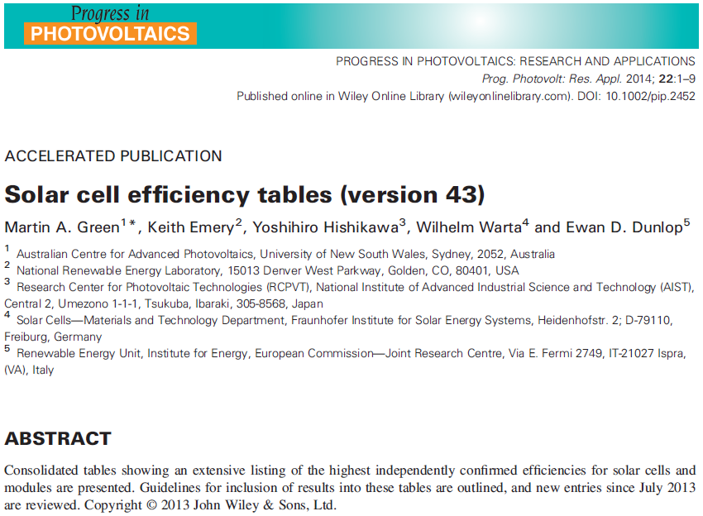
Progress in PV Efficiency Tables

Slide 5
World Record Cells (and sub-modules)
Criteria for inclusion
(cells):
Independently measured by a recognised test center elsewhere
Area > 1cm² (= total area!) for one sun devices
Other rules for mini-modules and concentrators
Categories
Silicon
III-V
Thin film
Perovskite / dye
Organic
Multi-junction

Slide 6
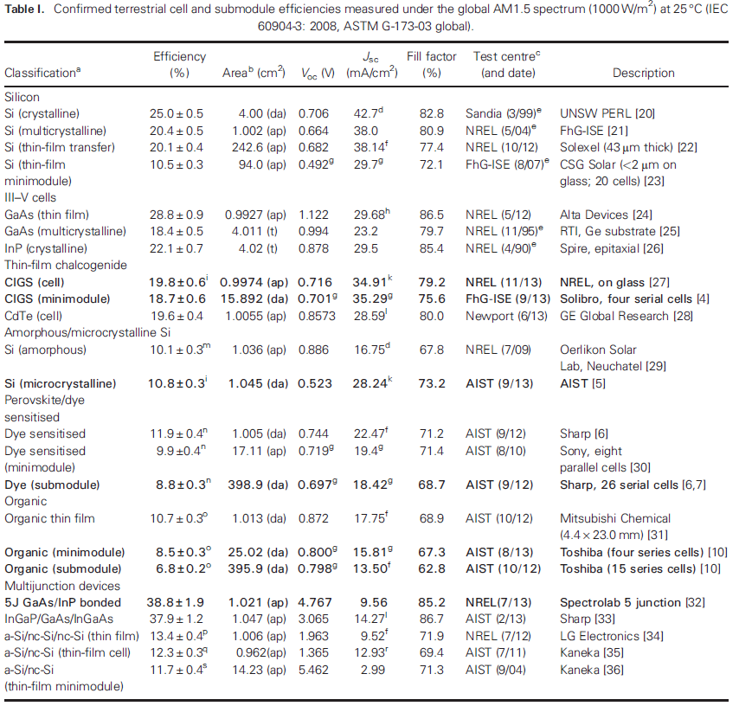
World Record Cells

Slide 7
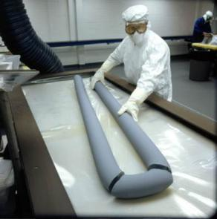
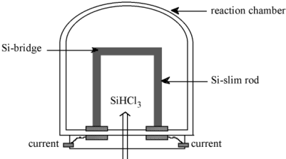
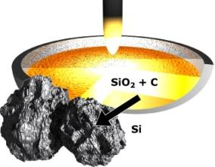
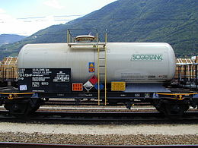
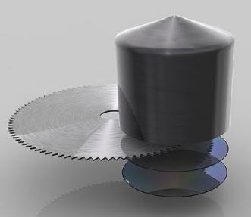
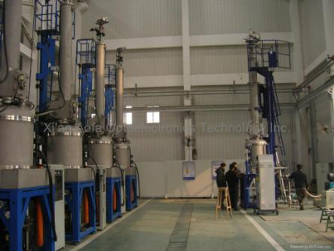
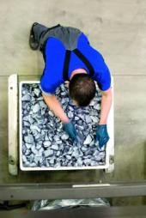
Purification of silicon
Sand
98% pure Si
HCl
SiHCl₃
Distil
Heat under H₂
Begin PV
production
Grow crystal
Or cast ingot
Pure Si
http://www.microchemicals.com/products/si_wafers/from_quartz_sand_to_silicon_wafers.html
http://www.solarworld.de/fileadmin/sites/sw/presse/bildmaterial/produktion/kristallisation_01_download.jpg
http://www.tomshardware.com/reviews/semiconductor-production-101,1590-3.html
http://cnx.org/content/m31994/latest/
http://www.resonancegroupusa.com/forum/index.php?topic=40.0

Slide 8
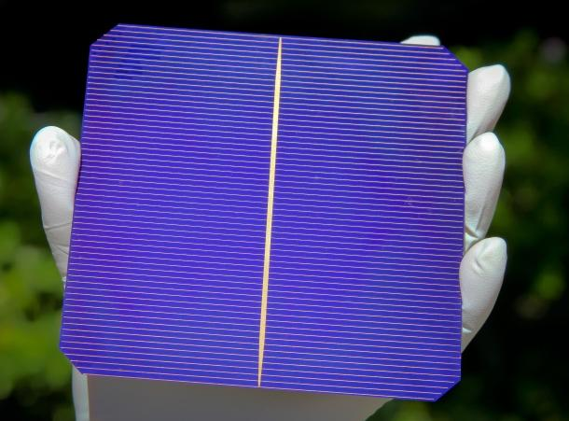
Silicon – the world leader
http://www.ubergizmo.com/2011/10/silevo-hybrid-solar-cell-challenges-conventional-wisdom/

Slide 9
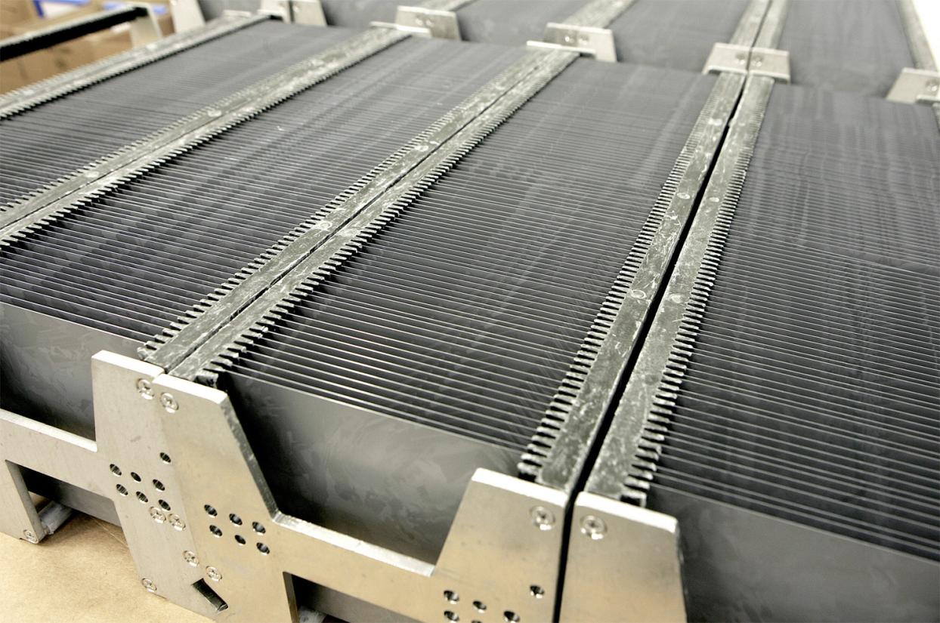
Si – large scale production

Slide 10
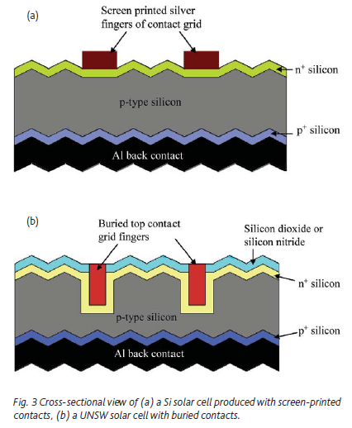
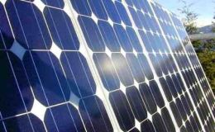
Silicon - crystalline

Slide 11
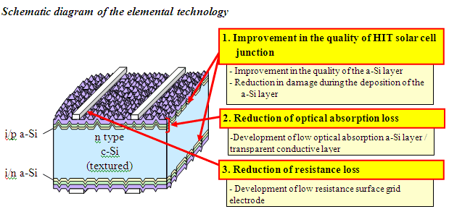
Silicon’s best – the Sanyo ‘HIT’ cell
‘Heterojunction with Intrinsic Thin layer’
http://us.sanyo.com/News/SANYO-Develops-HIT-Solar-Cells-with-World-s-Highest-Energy-Conversion-Efficiency-of-23-0-

Slide 12
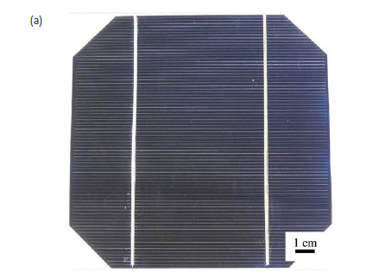
Silicon - crystalline
Pic from
Miles 2007

Slide 13
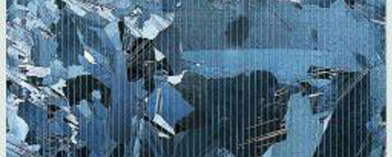
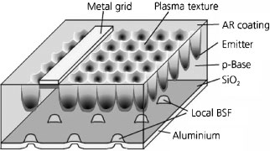
Silicon – multi-crystalline
Advantages
Cheaper than wafer silicon
Uses silicon processing technology
Disadvantages
5% less efficient than single crystal
(Highest efficiencies need exotic processing (left))
Ref 24 Shultz 2004

Slide 14
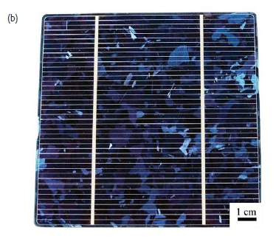
Silicon – multi-crystalline
Pic from
Miles 2007

Slide 15
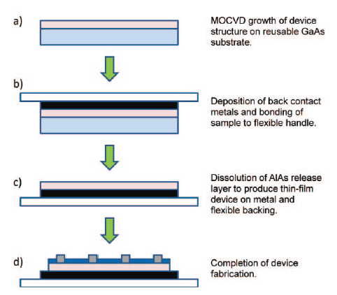
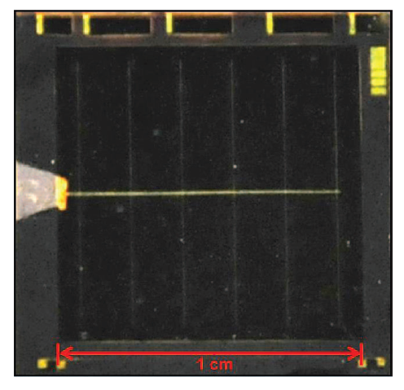
III-V
Ref 24 Kayes 2011

Slide 16
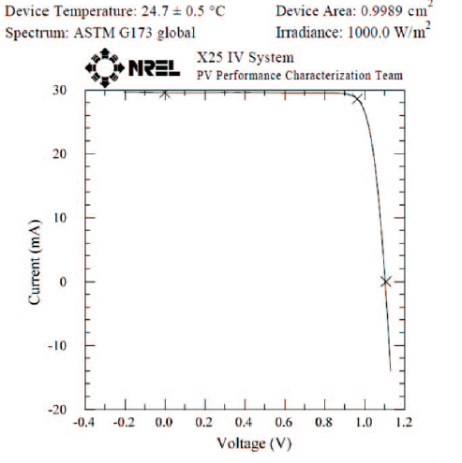
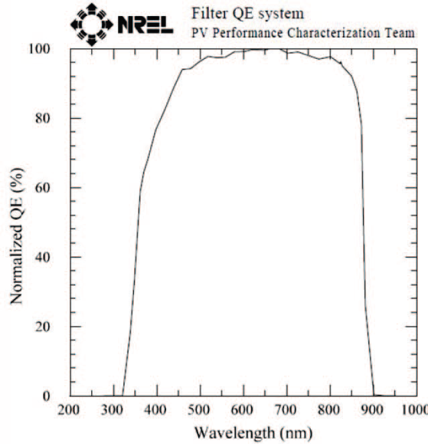
III-V
Ref 24 Kayes 2011

Slide 17
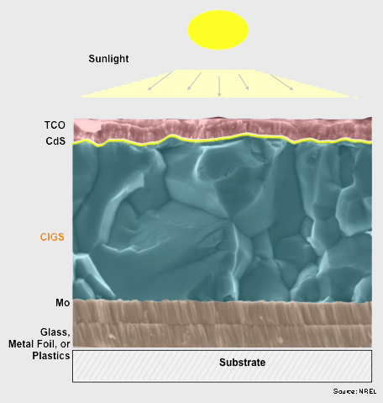
Thin film - CIGS
Strengths
High efficiency ~ 20%
Thin film construction
Issues
Complex material – chalcogen loss
In and Ga rare and expensive
Business hard to sustain – danger of it being undercut
Image from NREL

Slide 18
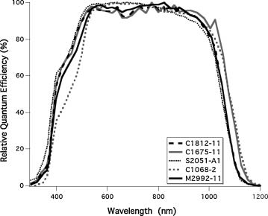
Thin film - CIGS
From ref 27 Repins 2008

Slide 19
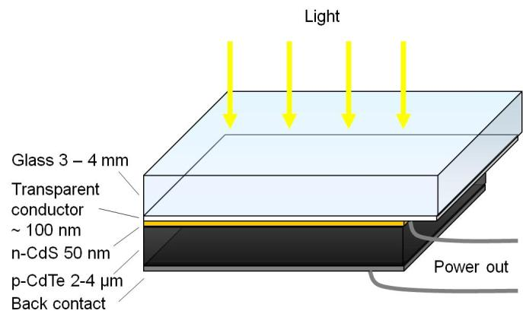
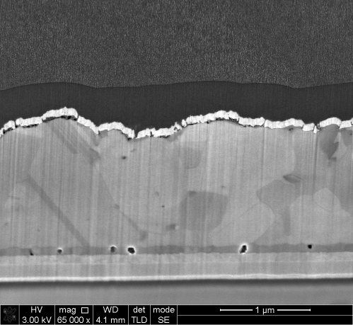
Thin film - CdTe
Strengths
Easy to produce
Cheapest PV you can buy
Main competitor to silicon
Major improvements in recent years 16 →20%
Weaknesses
Cd is toxic
Te is quite scarce

Slide 20
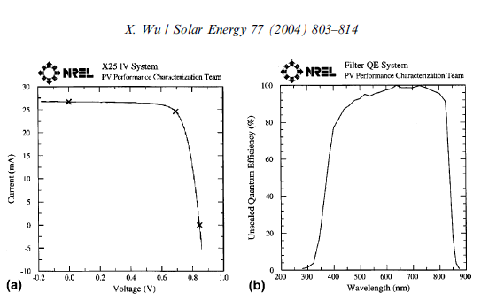
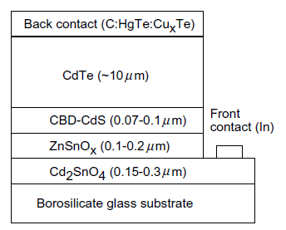
Thin film - CdTe
These graphs - Wu – about 16.5%

Slide 21
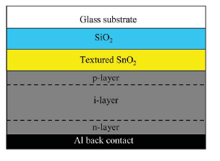
Thin film – amorphous silicon
Advantages
a-Si is a direct gap semiconductor! Dundee 1970’s
Problems
Its not stable
The efficiency is low
No longer in serious production
Pic from Miles 2007

Slide 22
Thin film – microcrystalline silicon
Advantage
Low cost thin film silicon could revolutionise solar power
Disadvantage
Silicon is an indirect gap material and does not absorb well →
Need to use tricks to get it to work
Ref 5 Sai – uses honeycomb textured substrate

Slide 23
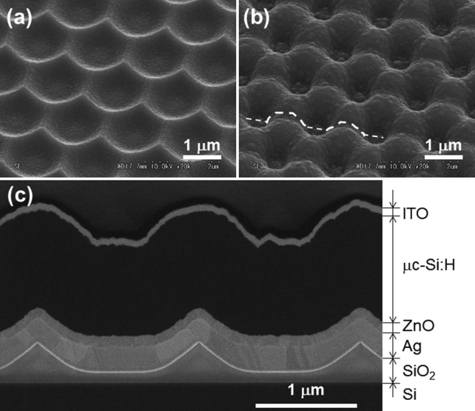
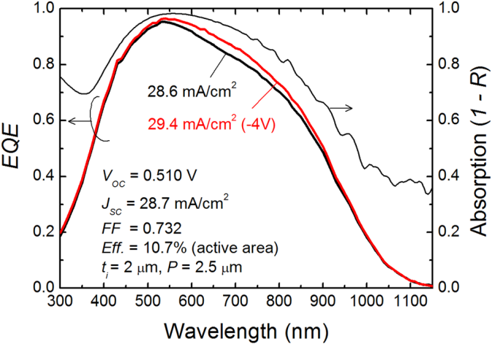
Thin film – microcrystalline silicon
Ref 5 Sai – uses honeycomb textured substrate

Slide 24
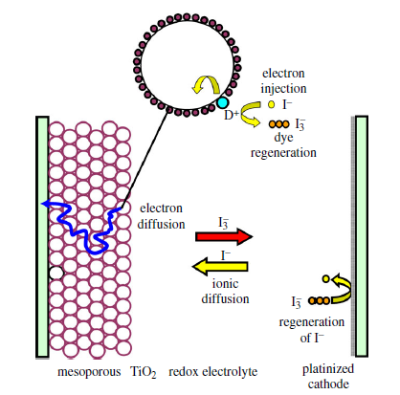
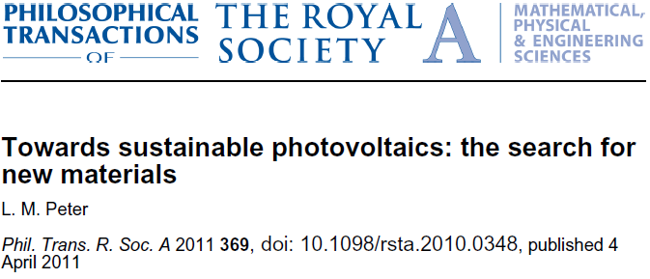
Dye
Strengths
Does not require high purity semiconducdtors
Potentially cheap to produce with simple equipment
Weaknesses
Liquid electrolyte causes instability
Efficiency seems to be stuck at just over 10%
More difficult to manufacture than expected

Slide 25
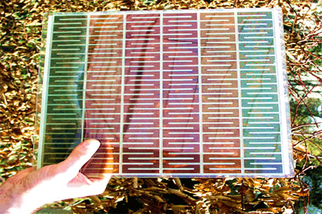
Dye

Slide 26
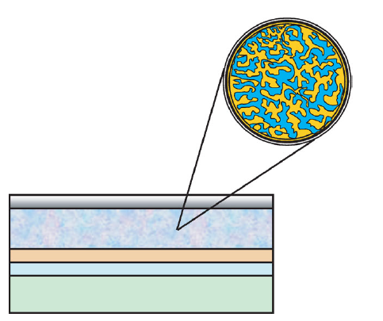
Organic
Bulk heterojunction:
P3HT – e donor
C60 derivative – e acceptor
Al electrode
PEDOT:PSS
Transparent conductor
glass
Image from L M Peter Royal Soc
P3HT – poly-3-hexyl-thiophene

Slide 27
Organic
Advantages
Has potential for low cost
Disadvantages
Unstable – absorption is an antibonding transition
Low efficiency
Companies can’t make it pay

Slide 28
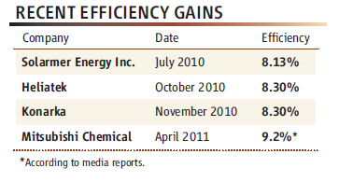
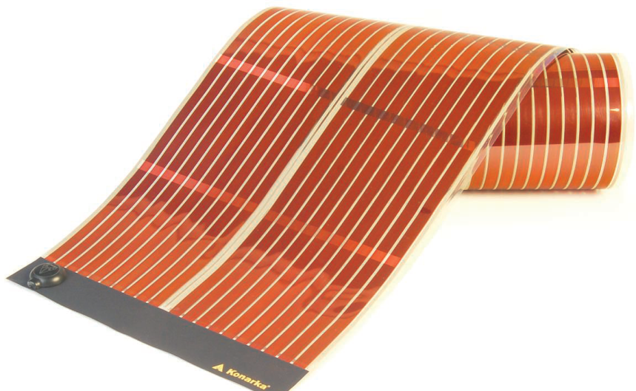
Organic
R Service Science 2011

Slide 29
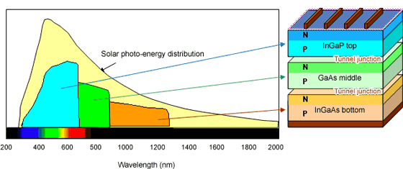
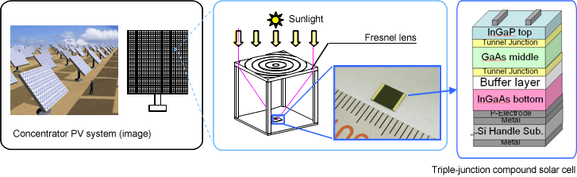
Multi-junction III-V
http://phys.org/news/2011-11-sharp-solar-cell-worlds-highest.html
http://www.semiconductor-today.com/news_items/2013/JUN/SHARP_190613.html

Slide 30
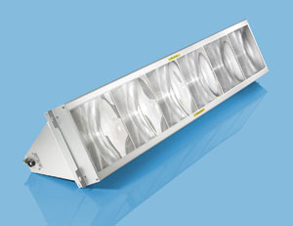
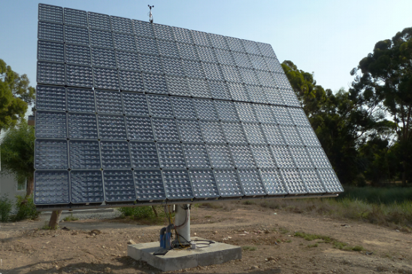
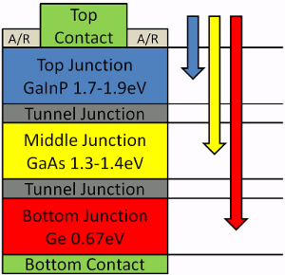
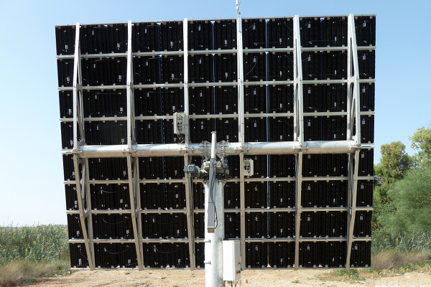
Multi-junction III-V
Concentrator
Tracker
600 x concentration
~40% efficient
Has accurate tracking system
Needs direct sunlight
Pics from Circadian Solar Ltd &
http://www.laserfocusworld.com

Slide 31
Multi-junction III-V
Advantages
Very high efficiency
Can be used with tracking concentrator systems
Disadvantages
High cost

Slide 32
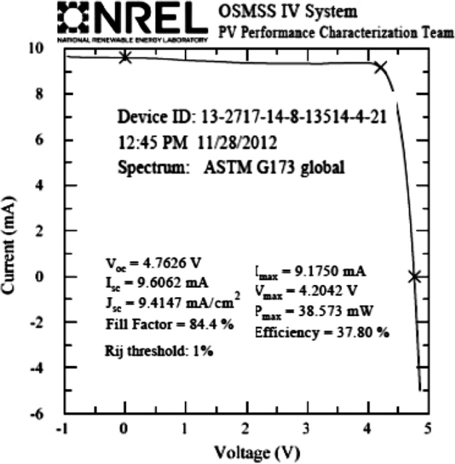
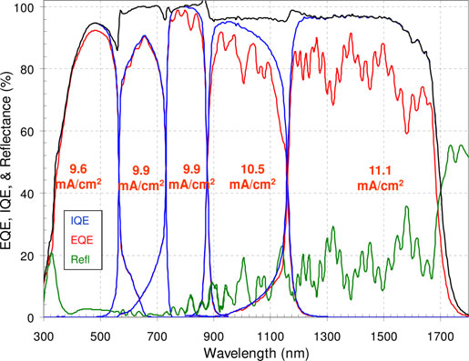
Multi-junction III-V
Ref 32 Chiu 2014

Slide 33
Multi-junction thin film silicon
Advantage
All-Si multijunction using
a-Si (1.7 eV)
Microcrystalline Si (1.1eV)
Disadvantage
Complex for the efficiency gained.

Slide 34
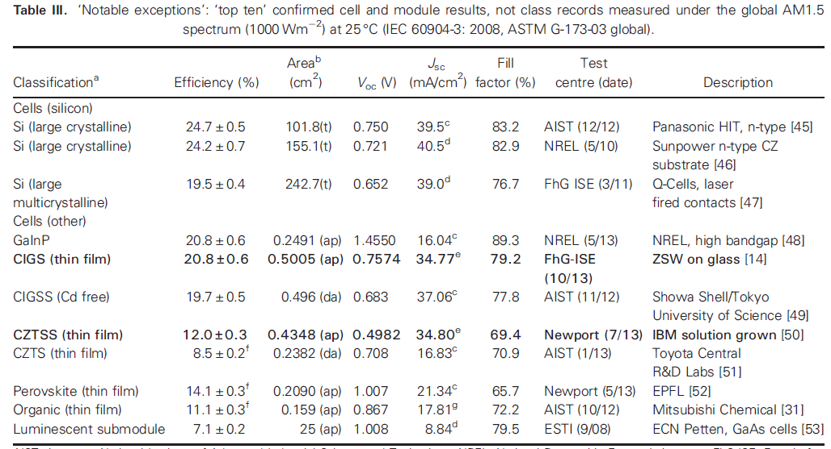
“Notable Exceptions”

Slide 35
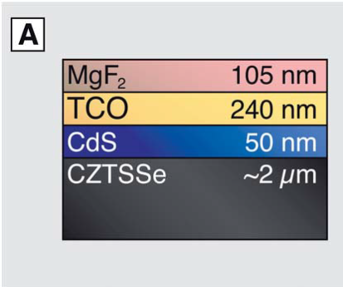
CZTSS = Cu₂ZnSn(S_{x}Se_{1-x})₄
50 Winkler
Eg = 1.16 eV; Voc = 0.5 V
- a 57% shortfall (very poor)
World annual production tonnes/year

Slide 36
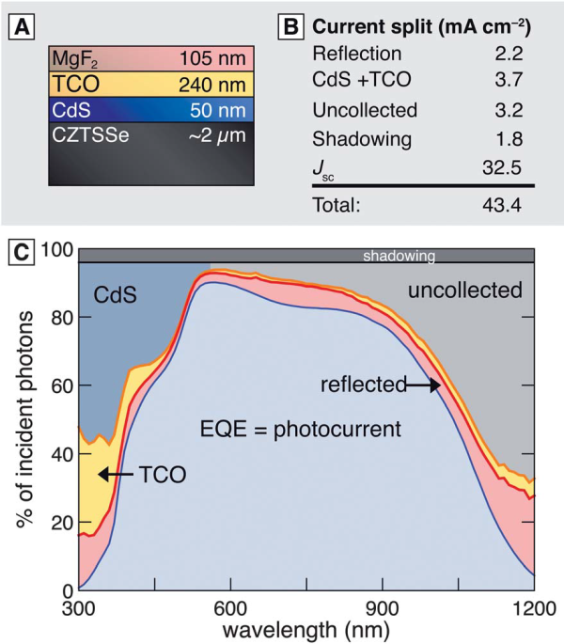

CZTSS

Slide 37



Hybrid Perovskite
Advantages:
Possible cheap PV route
Got efficient very quickly
Disadvantages:
Unstable, hysteretic, contains Pb

Slide 38
Other concepts

Slide 39
Intermediate band cells
Conduction band
Intermediate band
Valence band

Slide 40


Quantum dot cells
Rsc/ Univ Texas
ETH Zurich

Slide 41

Nanowire PV
TCO
CdS
CdTe
foil

